Slide 1
Utilizing Big Data
Kayla Wright
CTEC 298

Slide 2
OUTLINE
Introduction
CTEC 182 Items
Dataquest Python for Data Scientists
Jupyter Tutorial
Matplotlib Tutorial
Python Pandas Tutorial
Plot Visualizations

Slide 3

INTRODUCTION
According to the United Nations Food and Agriculture Organization (FAO), by 2050, our world population is expected to grow from 7.3 billion today to 9.7 billion.
Food production will have to increase by 70% if we are to feed everyone.
This presents an enormous challenge and creates the need to find sustainable ways to grow food to feed this expanding population.

Slide 4

CTEC 128 SCENARIO
Our world population is expected to grow from 7.3 billion today to 9.7 billion in the year 2050.
You work for Feed the Hungry (FH), a non-profit organization dedicated to fighting hunger and poverty across the globe
The organization’s leaders want to create a strategic plan for the future to ensure that there is enough food to feed everyone.

Slide 5
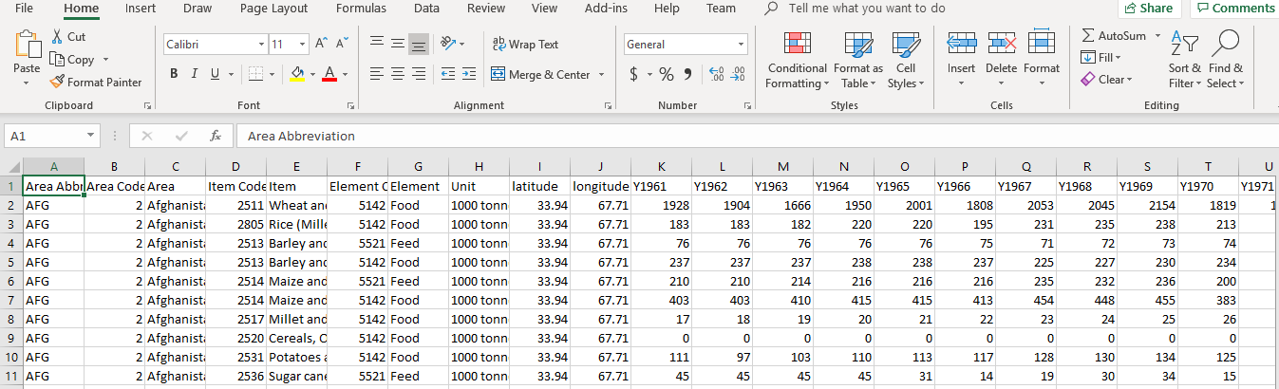
WORLD FOOD PRODCTION OBJECTIVE
Each team was given a data set to work with in order to narrow down some of their results
In the un-wrangled data set given for world food production, there were a total number of 64 variables and a total number of 12,748 observations..
Labels include, area abbreviation, item code, the item, element code, element, unit, latitude, longitude, and yearly production amount

Slide 6
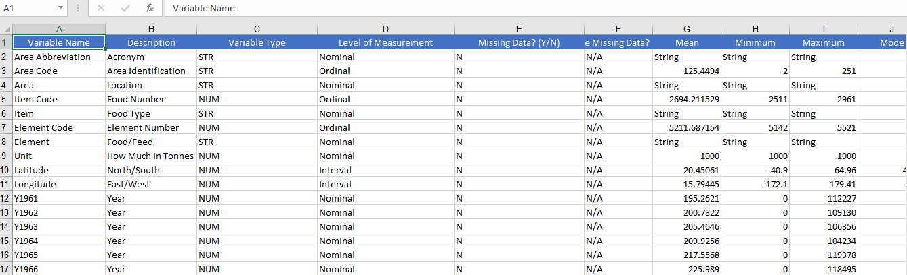
WRANGLED DATA SET
There are categories for each variable as well as variable types.
It includes headers like variable name, level of measurement and others.
Mathematical equations were included like mean, minimum and maximum

Slide 7
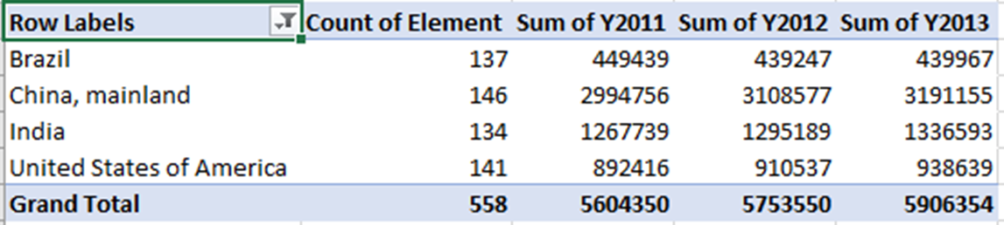
NARROWING DATA
The 4 top food producing countries are China, United States of America, India, Brazil
China, India and the United States are also the top 3 in the world population
We look at the food being produced and how they are so efficient at producing such volumes, use it as a model.

Slide 8
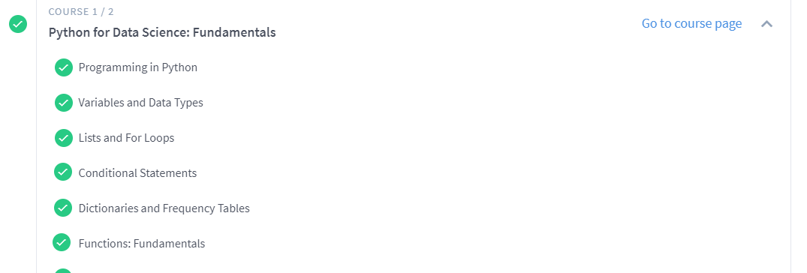
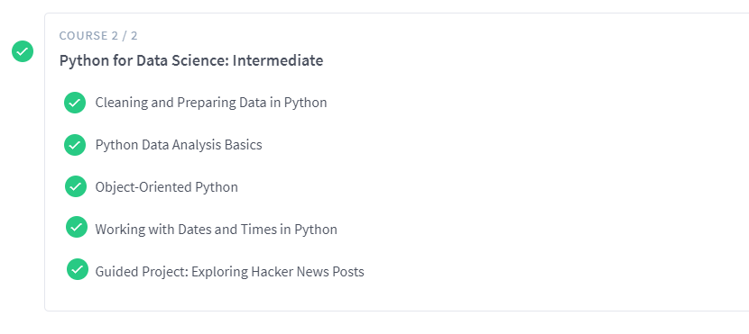
DATAQUEST
- Gives users the free opportunity to learn from several
different data science courses.
- For the Dataquest courses 1, and 2, we were expected to understand and learn python methods for programming.
- Course 1 covered python for data science fundamentals
- Course 2 covered intermediate python for data science

Slide 9
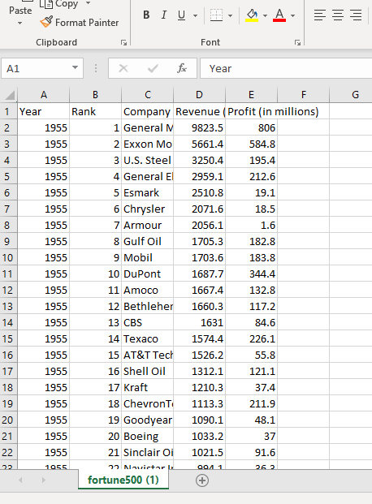
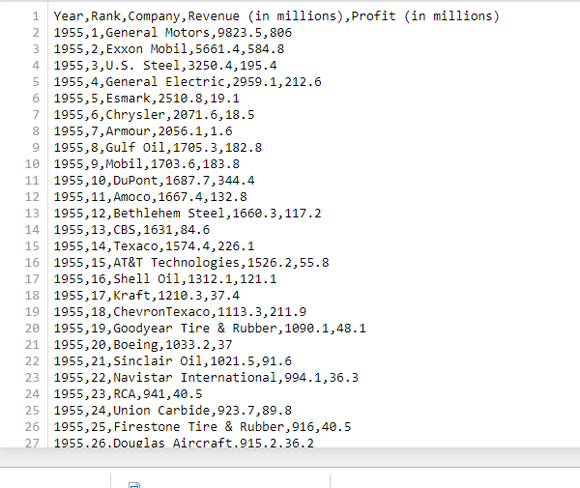
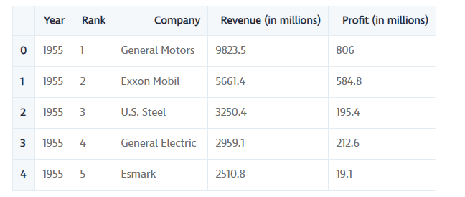
JUPYTER TUTORIAL
Jupyter notebook is used for developing and presenting data science projects. A notebook integrates code and its output into a single document that combines visualizations, narrative text, mathematical equations, and other rich media
This tutorial was used to get a feel of how to use Jupyter notebook
The goal is to our goal is to find out how the profits of the largest companies in the US changed historically. They have given a data set called fortune500

Slide 10
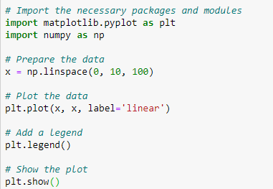
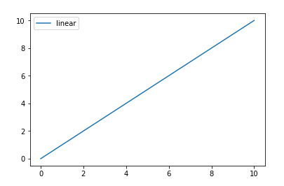
MATPLOTLIB TUTORIAL
- Matplotlib is the most popular plotting library in python. Using matplotlib, you can create pretty much any type of plot.
- You import the pyplot module of the matplotlib library under the alias plt. pyplot is a module in the matplotlib package. That’s why you often see matplotlib.pyplot in code

Slide 11
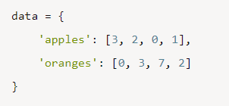
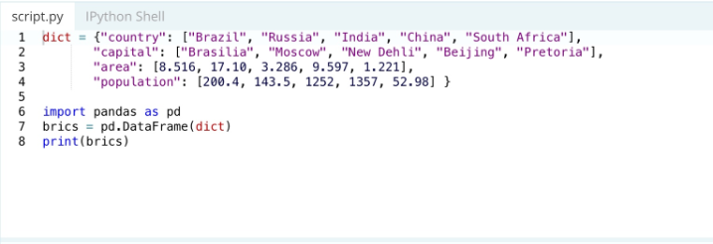
PYTHON PANDAS TUTORIAL
An open source library that is used to analyze data in Python
Pandas will extract the data from that CSV into a DataFrame — a table, basically — then let you do things like:
Store the cleaned, transformed data back into a CSV, other file or database
What's the average, median, max, or min of each column?
Does column A correlate with column B?
visualize the data with help from Matplotlib. Plot bars, lines, histograms, bubbles, and more.
Each (key, value) item in data corresponds to a column in the resulting DataFrame.

Slide 12
WHAT IS VISUALIZATION?
The use of data visualization gives you the ability to present data in a pictorial or graphical format.
This allows you to analyze, and transform your data
The 6 different plots used for the plot deliverables consisted of, scatter plots, bar graphs, histograms, pie plot/chart, stack/area plot, and multiplot graph

Slide 13
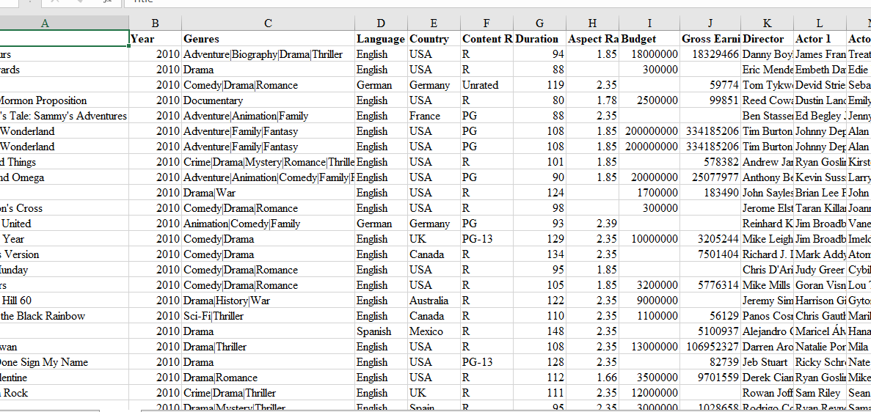
BAR GRAPH
A bar graph is used to compare data between groups and measure changes over time
One axis of the plot shows the categories being compared and the other represents measured value
Before you are able to use any of your data, you have to upload the csv file to the Jupyter notebook.

Slide 14
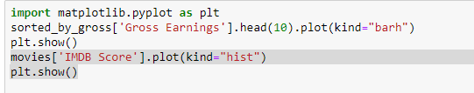
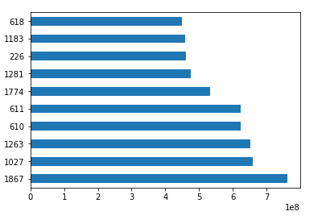
CONTINUED…
Barh tells us that the chart will be a horizontal bar graph.

Slide 15
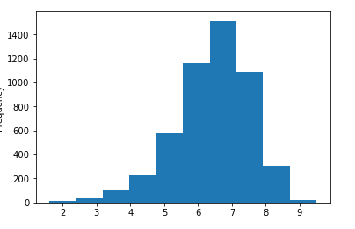
HISTOGRAM
Used to represent data given in the form of some groups
Histograms are a good way to visualize the distribution of a data set. We use the plot method on the IMDB Scores series from our movies DataFrame and pass it the argument.

Slide 16
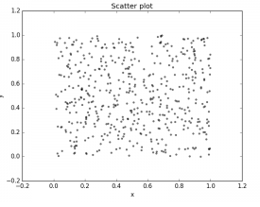
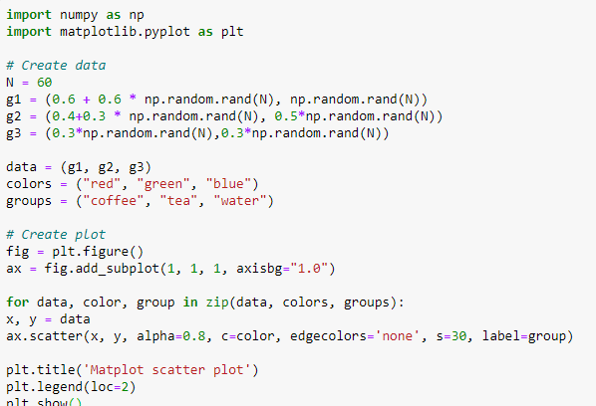
SCATTERPLOT
Used to compare two or more variables
A scatter plot is a type of plot that shows the data as a collection of points. The position of a point depends on its two-dimensional value, where each value is a position on either the horizontal or vertical dimension

Slide 17
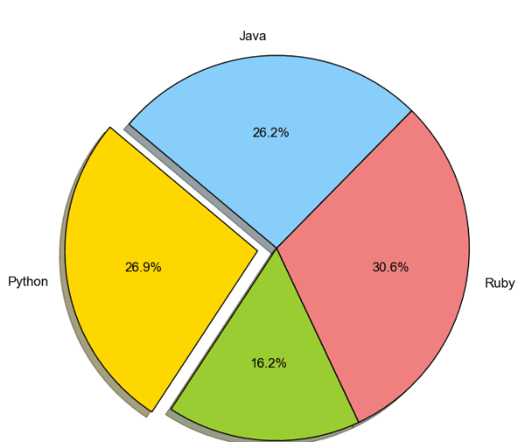
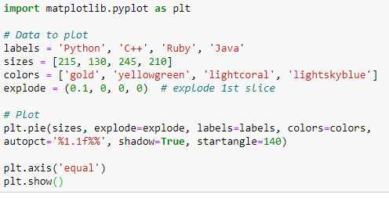
PIE CHART
Categorical data
Pie object is a circular statistical chart, which is divided into sectors to illustrate numerical proportion. Data visualized by the sectors of the pie is set in values. The sector labels are set in labels. The sector colors are set in marker.colors.

Slide 18
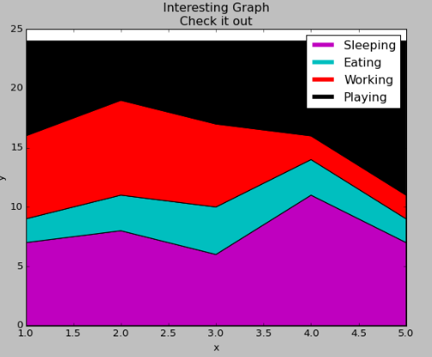
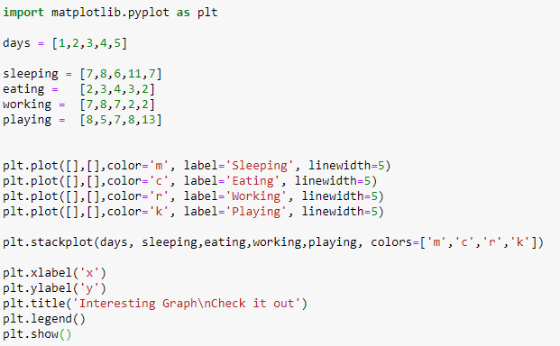
STACK/AREA PLOT
Track changes over time
Show how each part makes a whole
All I did here was plot some empty lines, giving them the same colors, and the correct labels in accordance with our stack plot.
I gave them a linewidth of 5, to make the lines a bit thicker in the legend. Now, we can easily see how we're spending our days!

Slide 19
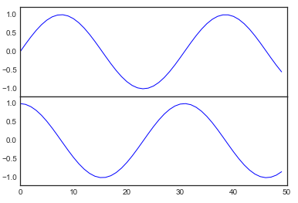
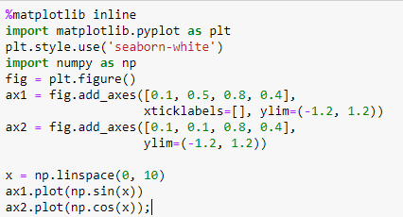
MULTIPLOT GRAPH
Graph showing subplots for 2 or more sets of data
Sometimes it is helpful to compare different views of data side by side.
To this end, Matplotlib has the concept of subplots: groups of smaller axes that can exist together within a single figure.
These subplots might be insets, grids of plots, or other more complicated layouts.

Slide 20
CONCLUSION
Data visualization like the use of charts, line charts help to visualize data in a compact and precise format which makes it easy to rapidly scan information in order to understand trends. is important to design the right visualizations for your data to allow yourself and team members to interpret and make decisions based off of what they observe.

Slide 21

REFERENCES
GargEntrepreneur, H. (2019, July 29). Excel Tutorial for Python and Pandas. Retrieved from https://www.dataquest.io/blog/excel-and-pandas/.
Matplotlib scatterplot. (2015, May 30). Retrieved from https://pythonspot.com/matplotlib-scatterplot/.
Matplotlib Tutorial: Python Plotting. (n.d.). Retrieved from https://www.datacamp.com/community/tutorials/matplotlib-tutorial-python.
PrykePython, B., FinTech, & Machina Capital. (2019, September 11). Jupyter Notebook for Beginners Tutorial. Retrieved from https://www.dataquest.io/blog/jupyter-notebook-tutorial/

